Slide 1
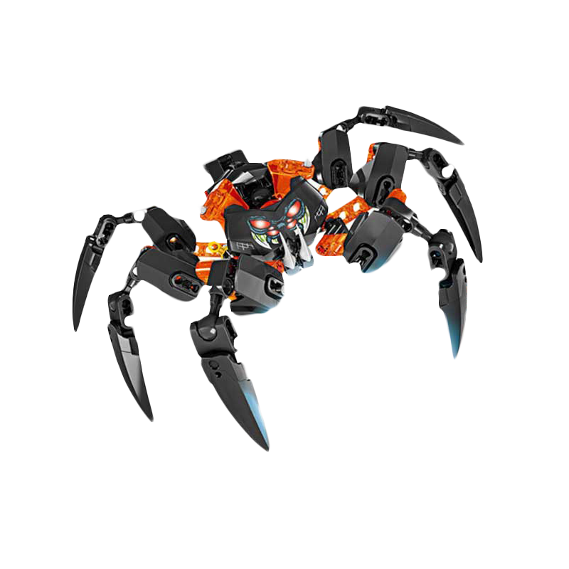
Web Crawler
Venkatachalam C - 223003107
S Aswin - 223003014
Proceed?
Yes
Cancel

Slide 2
Table of contents
01
02
Introduction
Libraries& Protocols
Workflow& Methodology
04
Output
03

Slide 3
01
Introduction
A bit of introduction about our “Spyder bot”

Slide 4
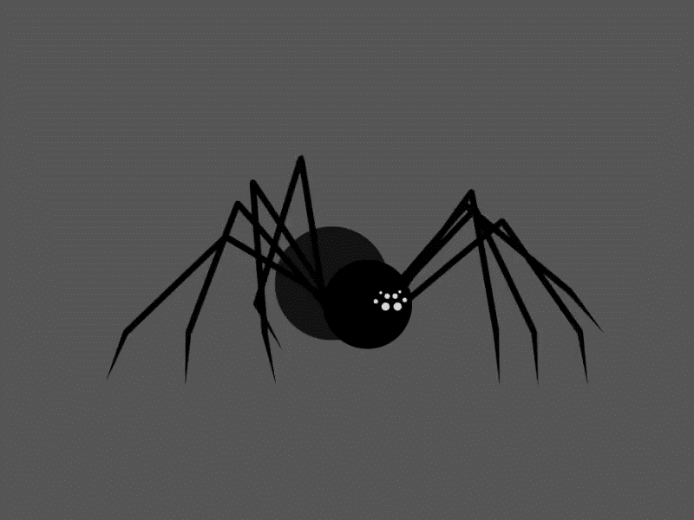
Introduction
1) Spider is a bot that is used for crawling required data from the target website. 2) Under the hood all search engines use spider to provide efficient results by ranking pages appropriately. 3)It collects all or some specific hyperlinks and html content from websites and indexes them in a suitable manner

Slide 5
02
Libraries & Protocols

Slide 6

* Python 3.x * scrapy – py framework to crawl websites * Tkinter – py library for user interface
OK
OK
OK

Slide 7
Protocols
SMTP
HTTP
Client
Server
SMTP
CLIENT
SMTP
SERVER
Request
Response
INTERNET
HTTP stands for Hyper Text Transfer Protocol.
It is a protocol used to access the data on the World Wide Web (www).
The HTTP protocol can be used to transfer the data in the form of plain text, hypertext, audio, video,
SMTP stands for Simple Mail Transfer Protocol.
It is a program used for sending messages to other computer users based on e-mail addresses.

Slide 8
03
Workflow & Methodology

Slide 9
Workflow
* User provides initial URL which servers as the entry point for links to pages that needs to be crawled by spider.
* Crawler fetches URL of all linked pages from the raw html of every visited page
* Adds all the URL to a queue.
* Traverse the queue to fetch and crawl every url and repeat the above steps 1 through 3.
* If a stop condition i.e depth provided by user is met then stop crawling, otherwise crawl until no more URL shows up.
Continue

Slide 10
Working methodology
Fetch each URL from the queue and repeat the process
Fetch an Parse those URL’s
Step 1
Step 2
Step 3
Step 4
Begin with a list of URL’s
Extract URL’s they point to and place them in a queue

Slide 11
Output

Slide 12
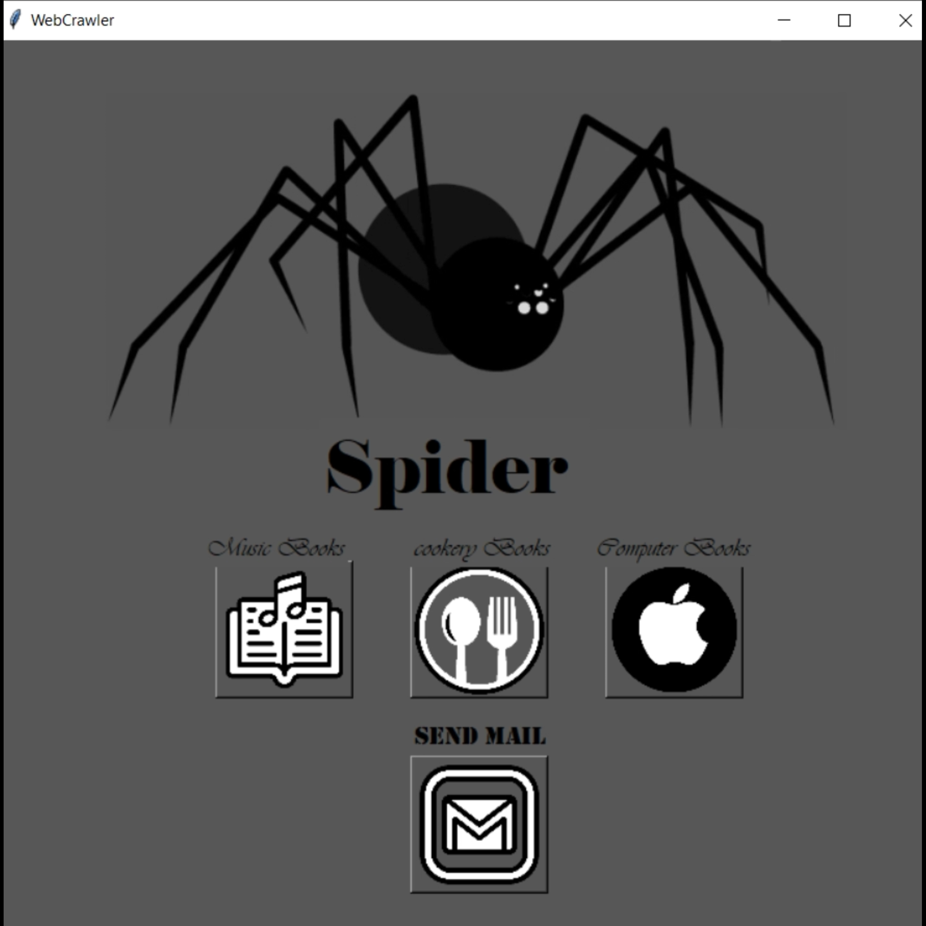

Slide 13
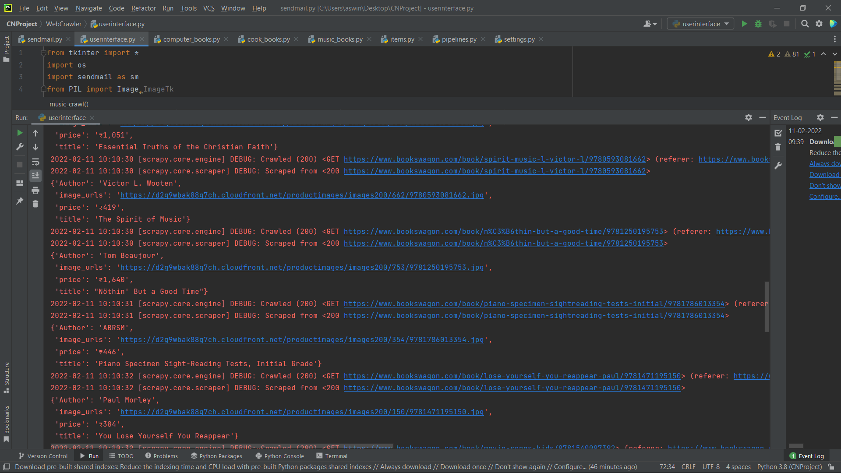

Slide 14
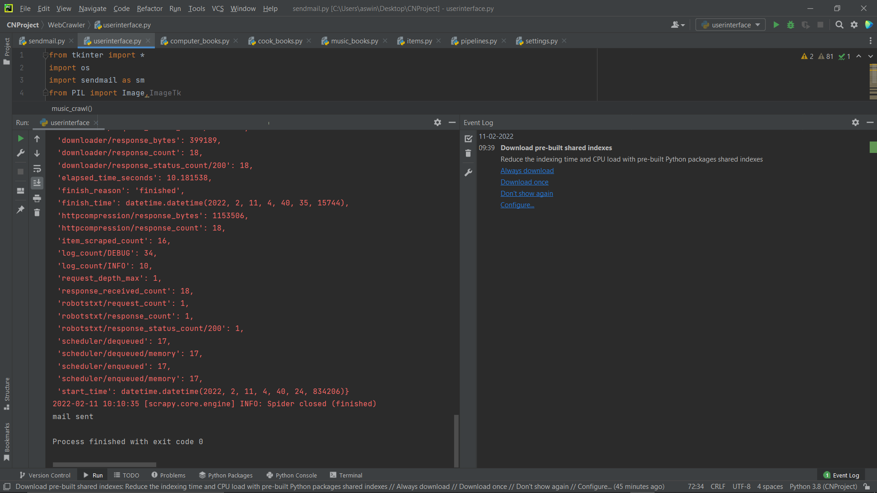

Slide 15
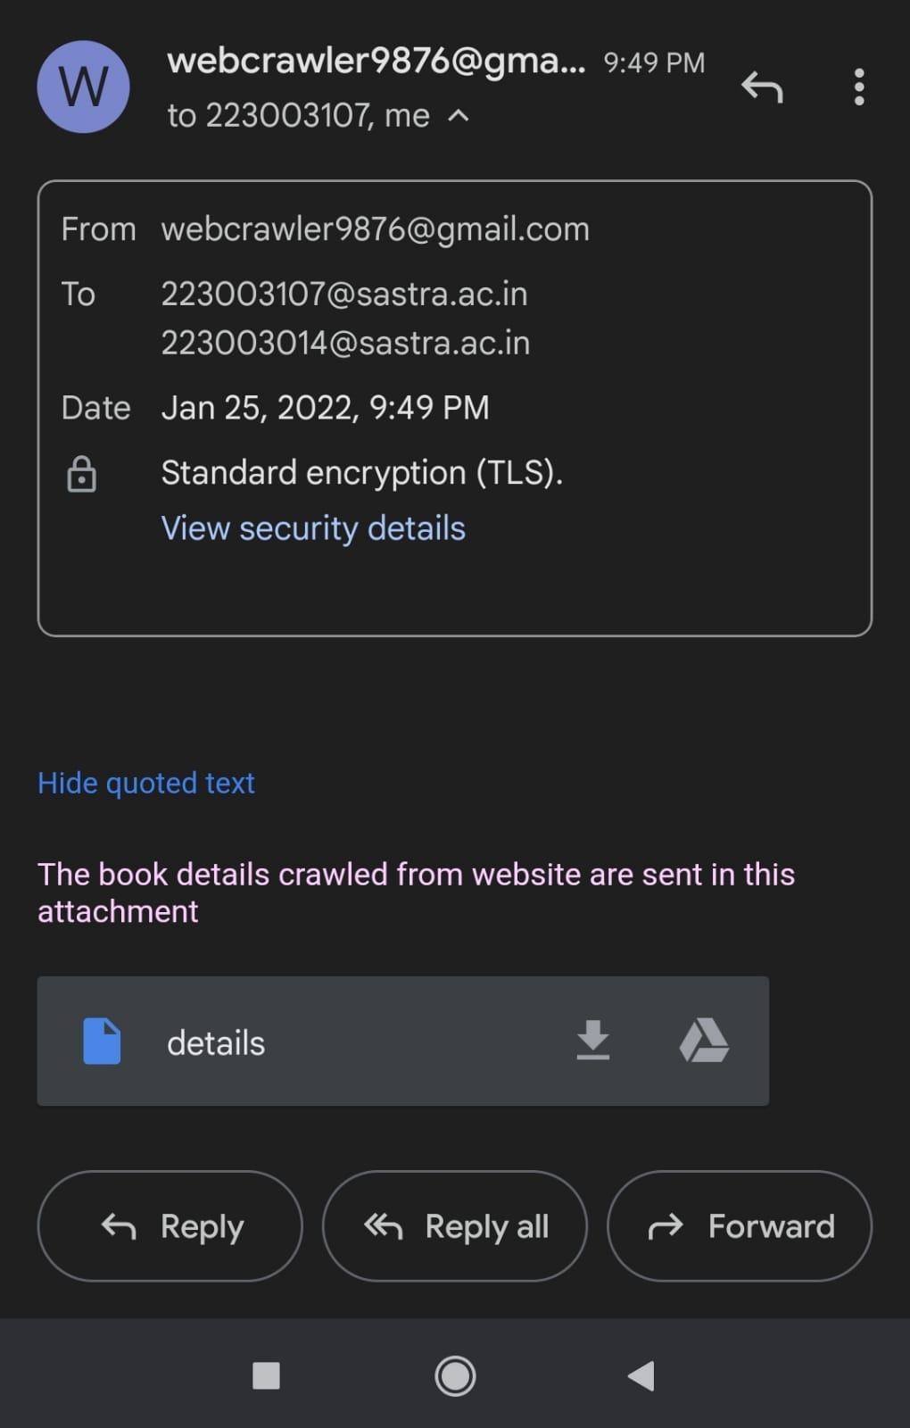

Slide 16
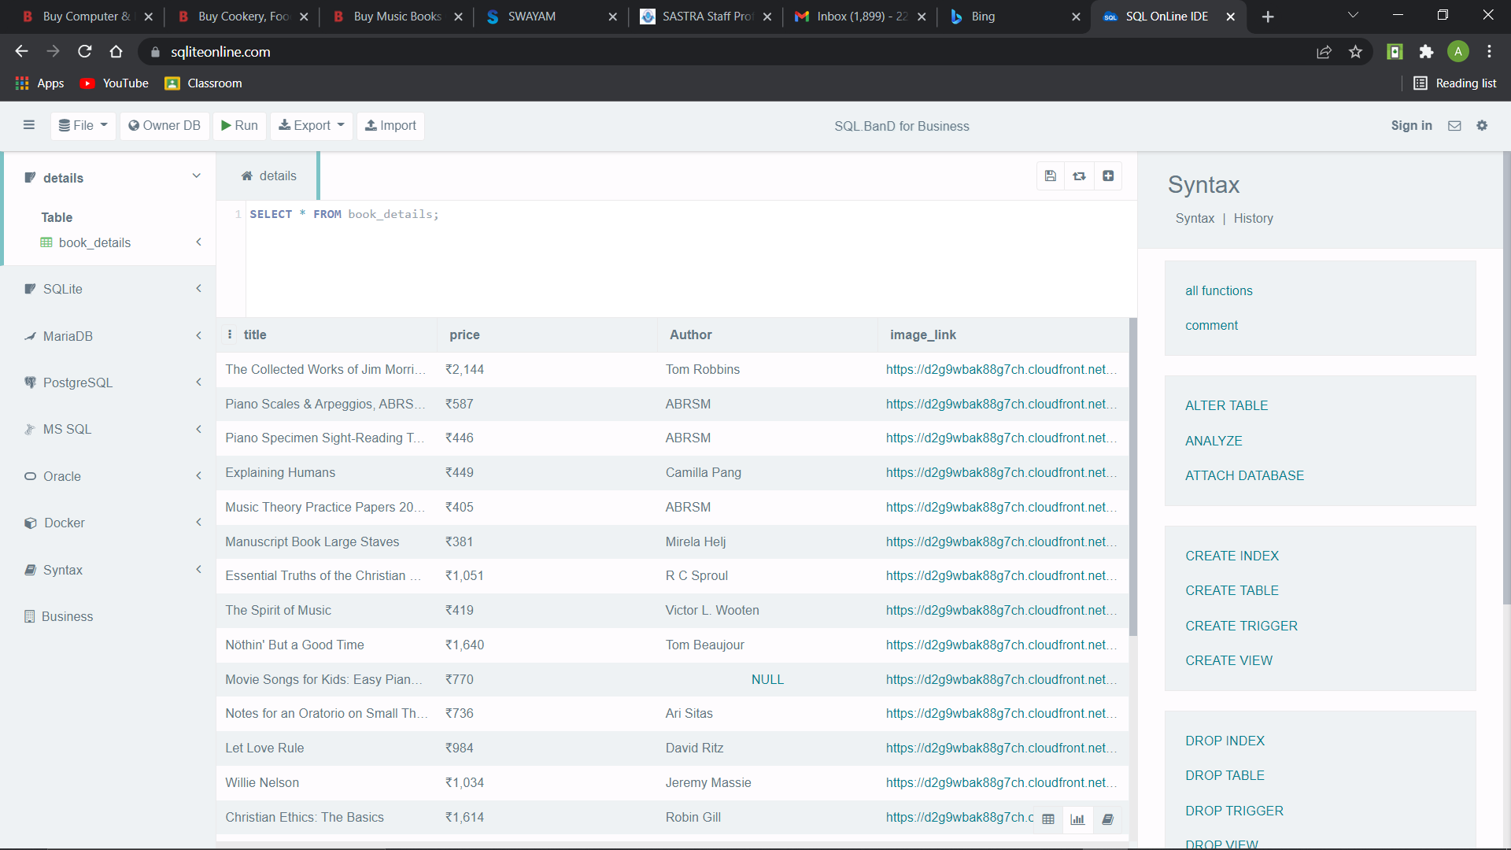

Slide 17
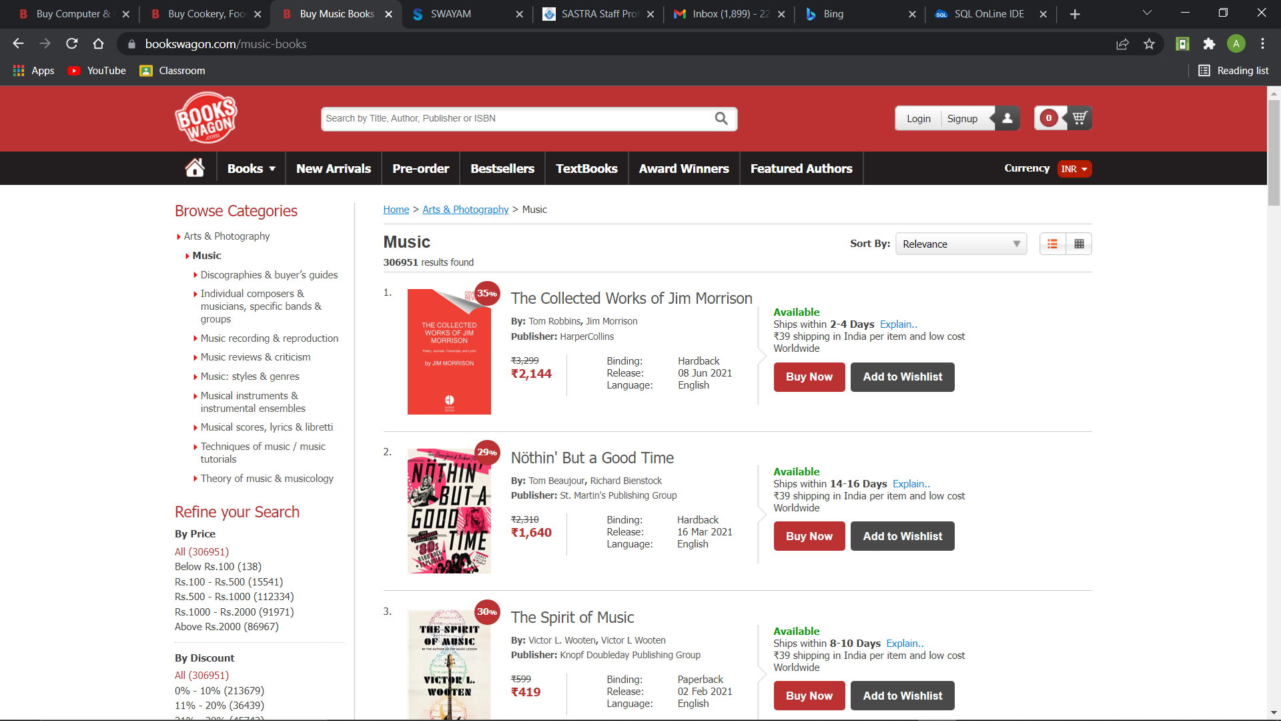

Slide 18
The End Thank you

